Slide 2
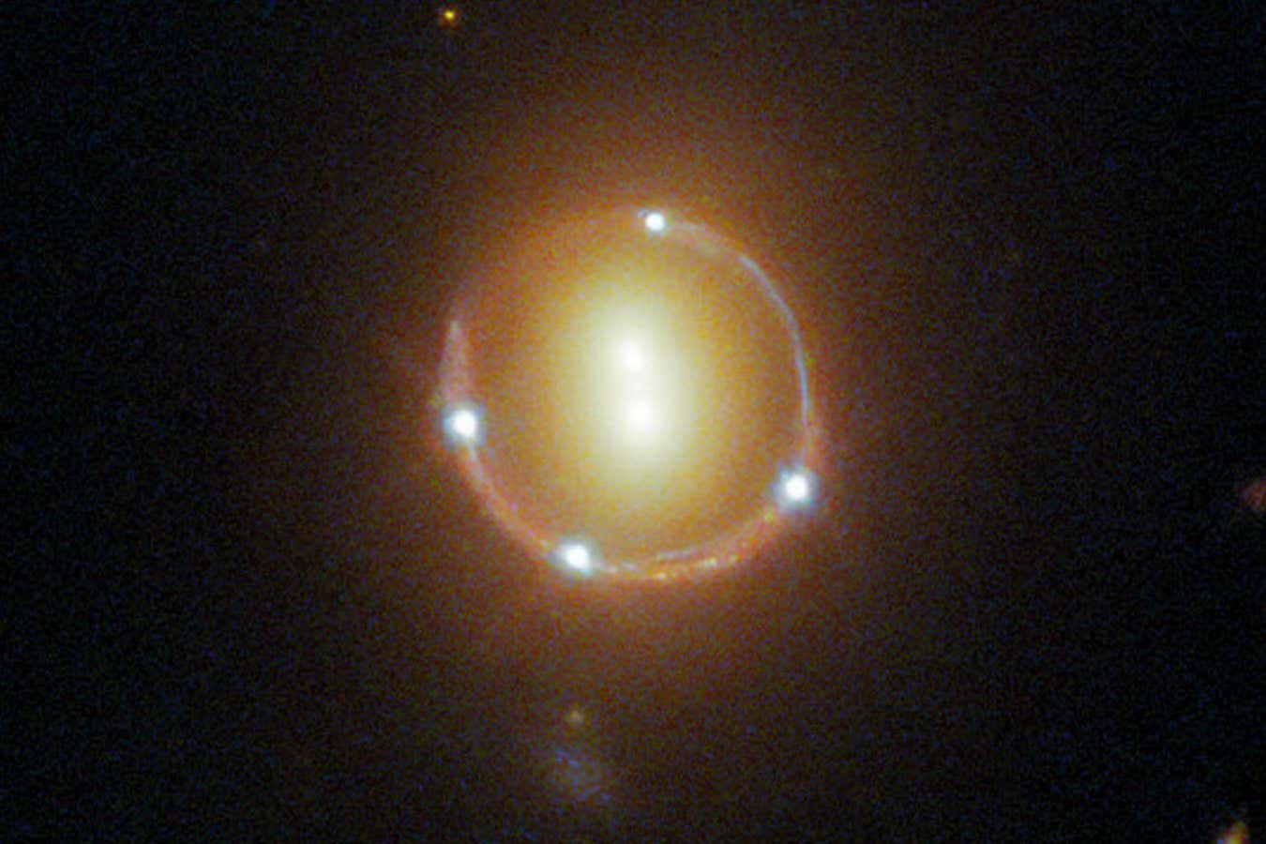

Slide 3
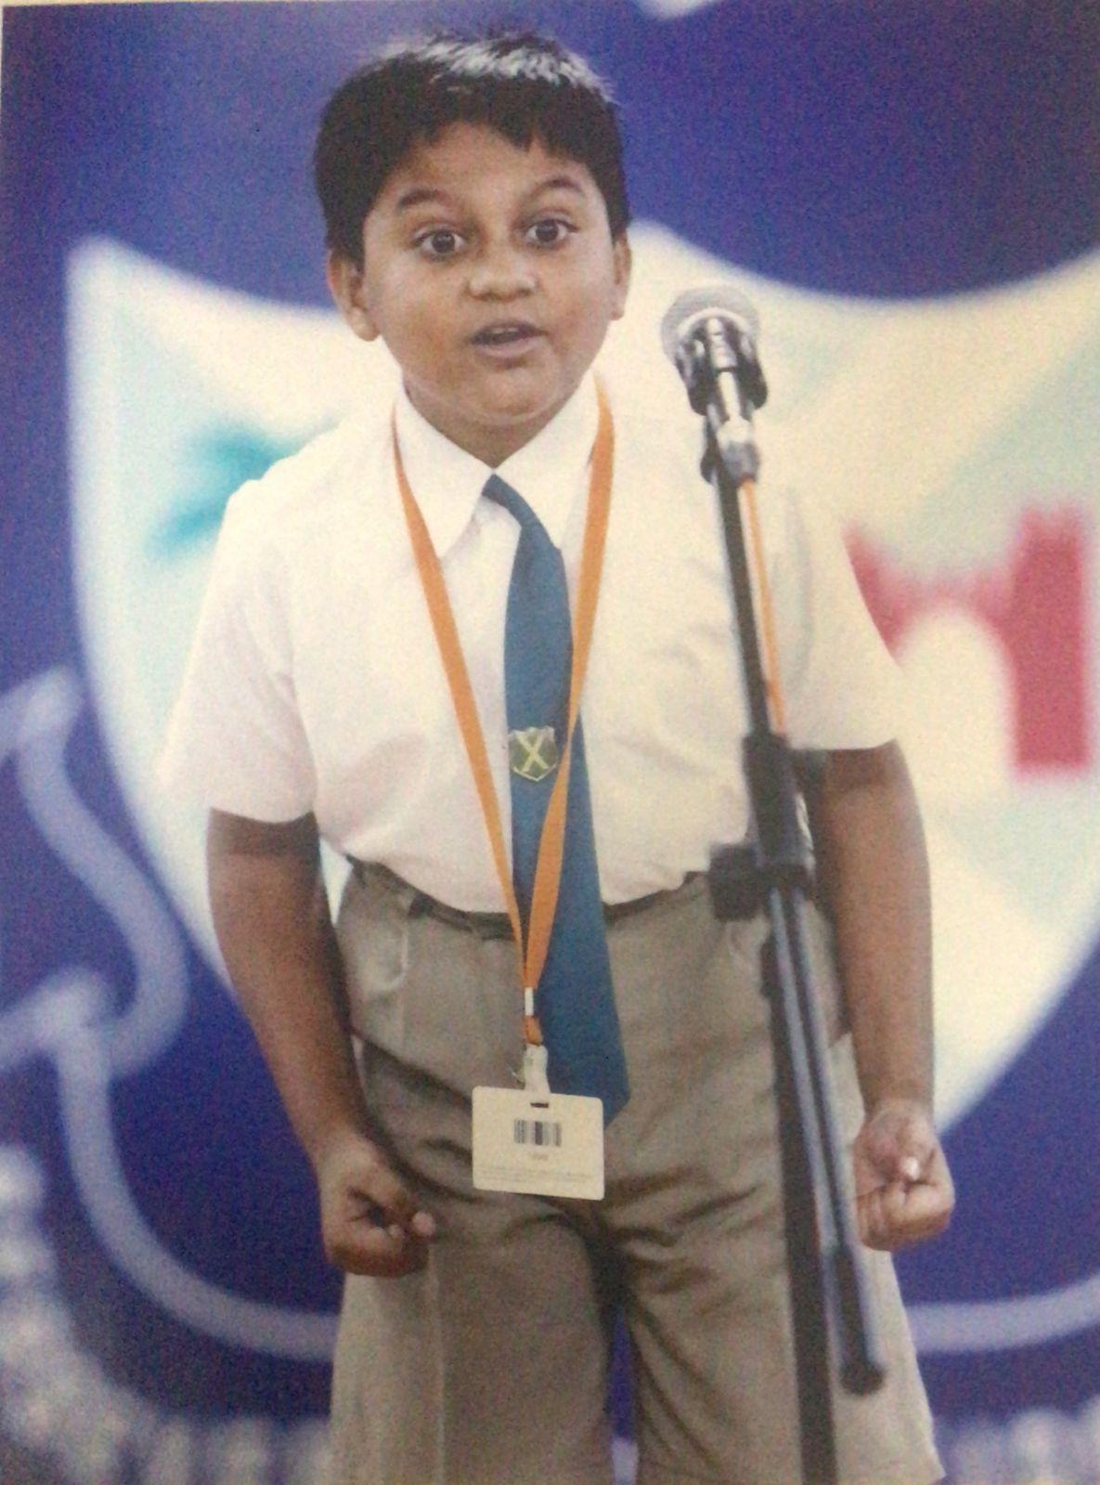
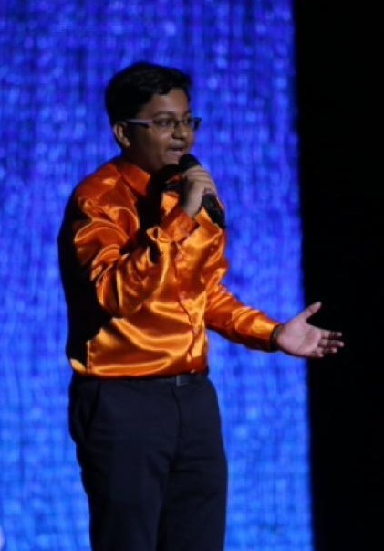

Slide 4
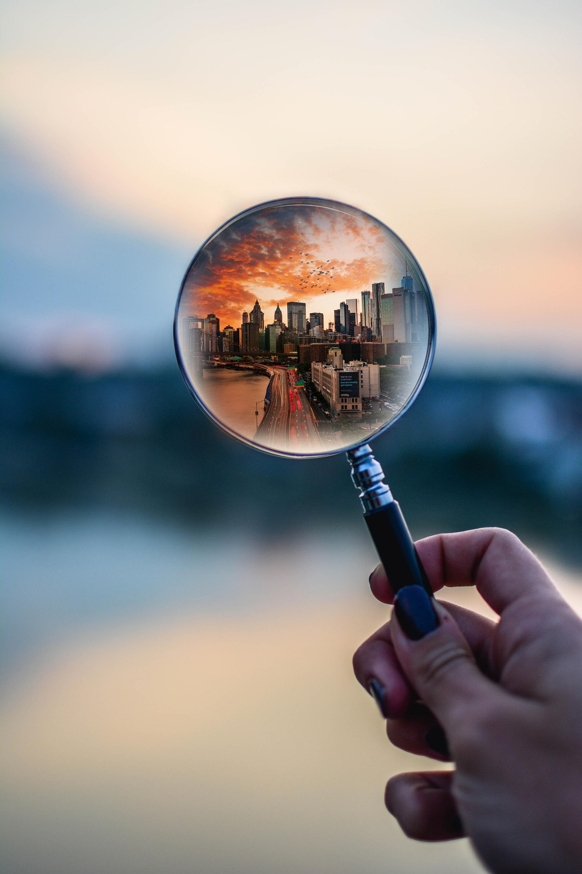
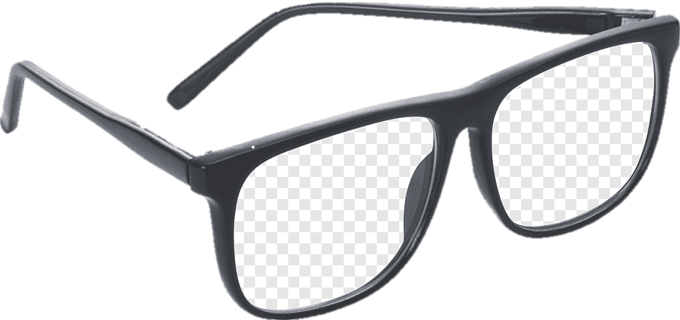
LENS
Magnification
Make Image Clearer

Slide 5
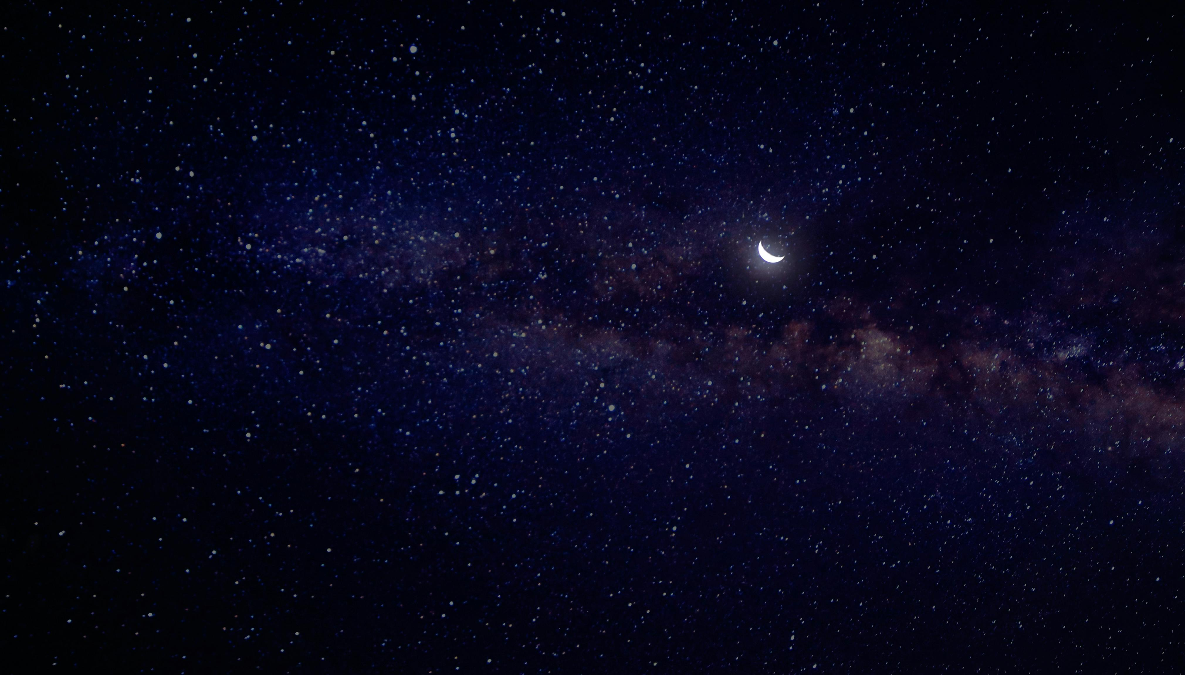
Gravitational Lens Modelling of an IllustrisTNG Mock Multiply Lensed Supernova
Rommulus Francis Lewis
Final Year Project
Supervisor: Prof Jeremy Lim

Slide 6
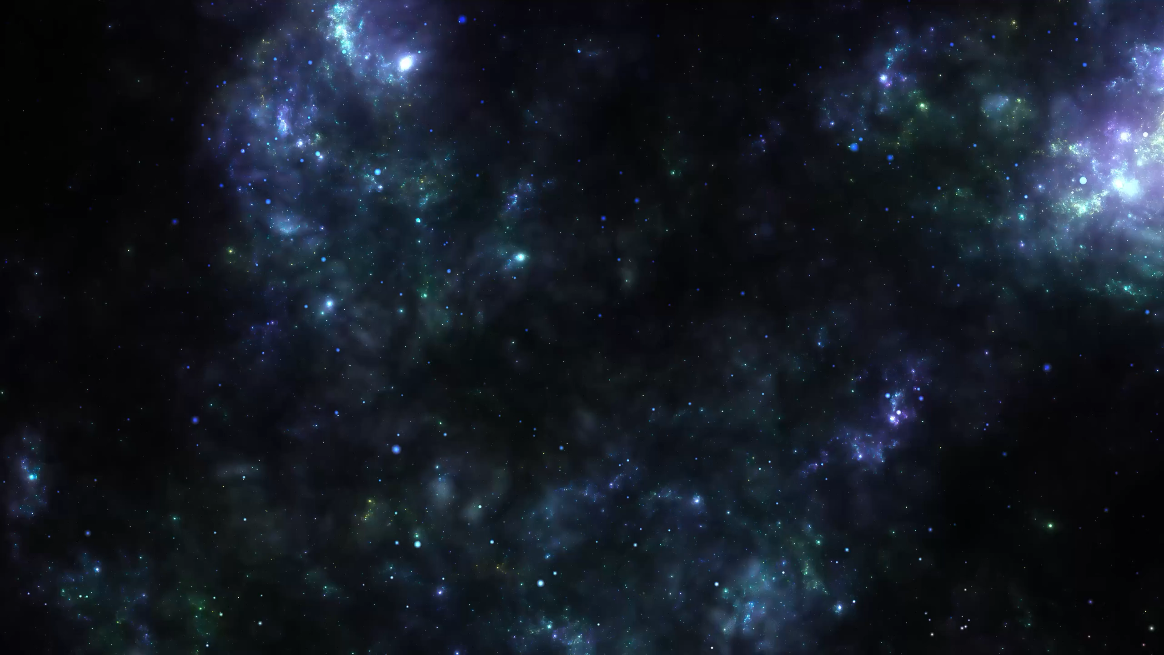
Gravitational Lens Modelling of an IllustrisTNG Mock Multiply Lensed Supernova
Rommulus Francis Lewis
Final Year Project
Supervisor: Prof Jeremy Lim

Slide 7
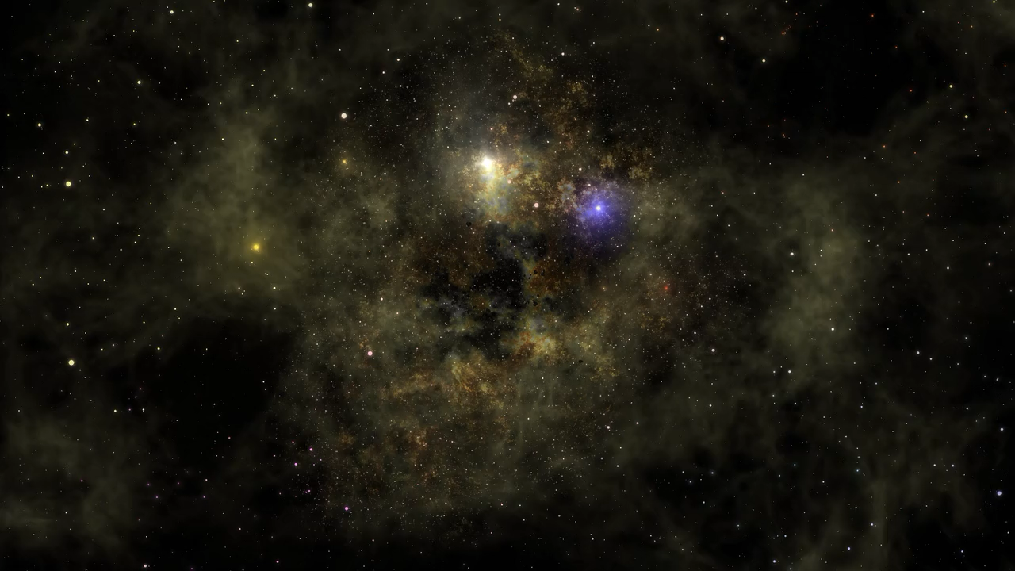
Gravitational Lens Modelling of an IllustrisTNG Mock Multiply Lensed Supernova
Rommulus Francis Lewis
Final Year Project
Supervisor: Prof Jeremy Lim

Slide 8
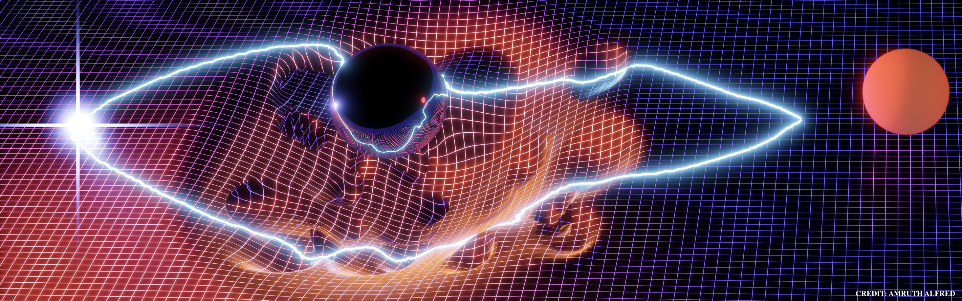
Gravitational Lensing

Slide 9
Data
Galaxy from the IllustrisTNG suite

Slide 10
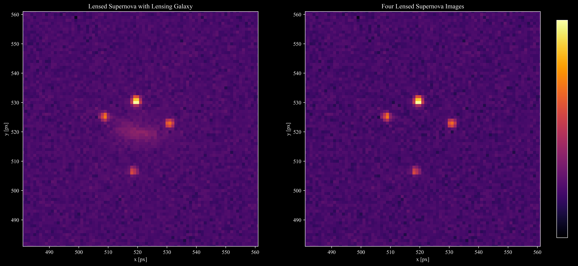
Data

Slide 11
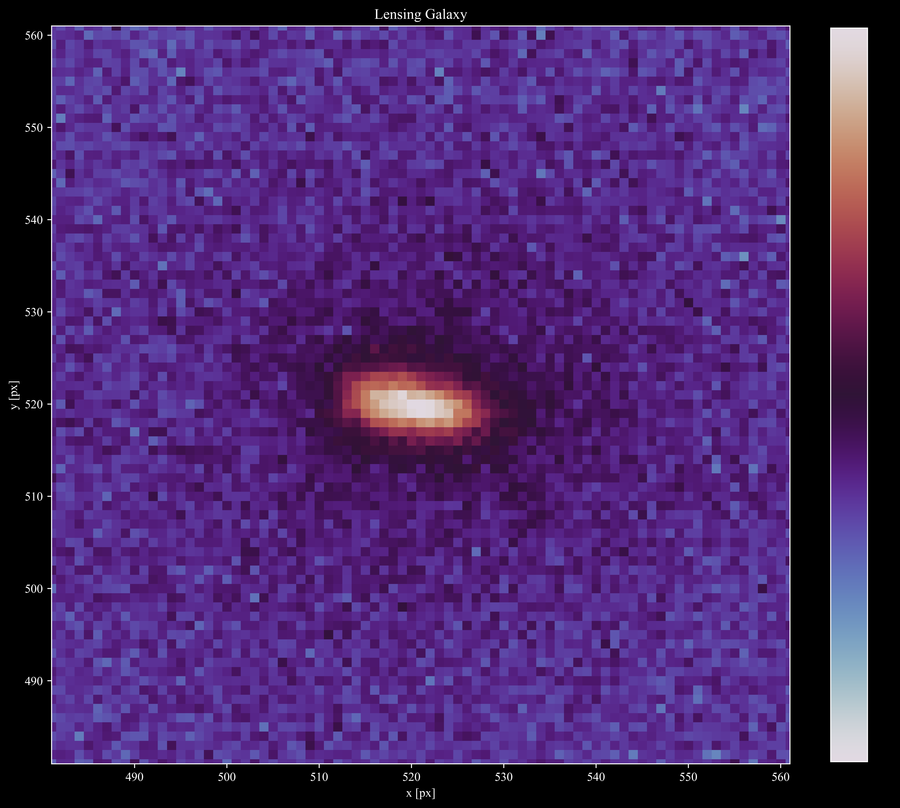
Data

Slide 12
Lens Modelling

